Slide 1

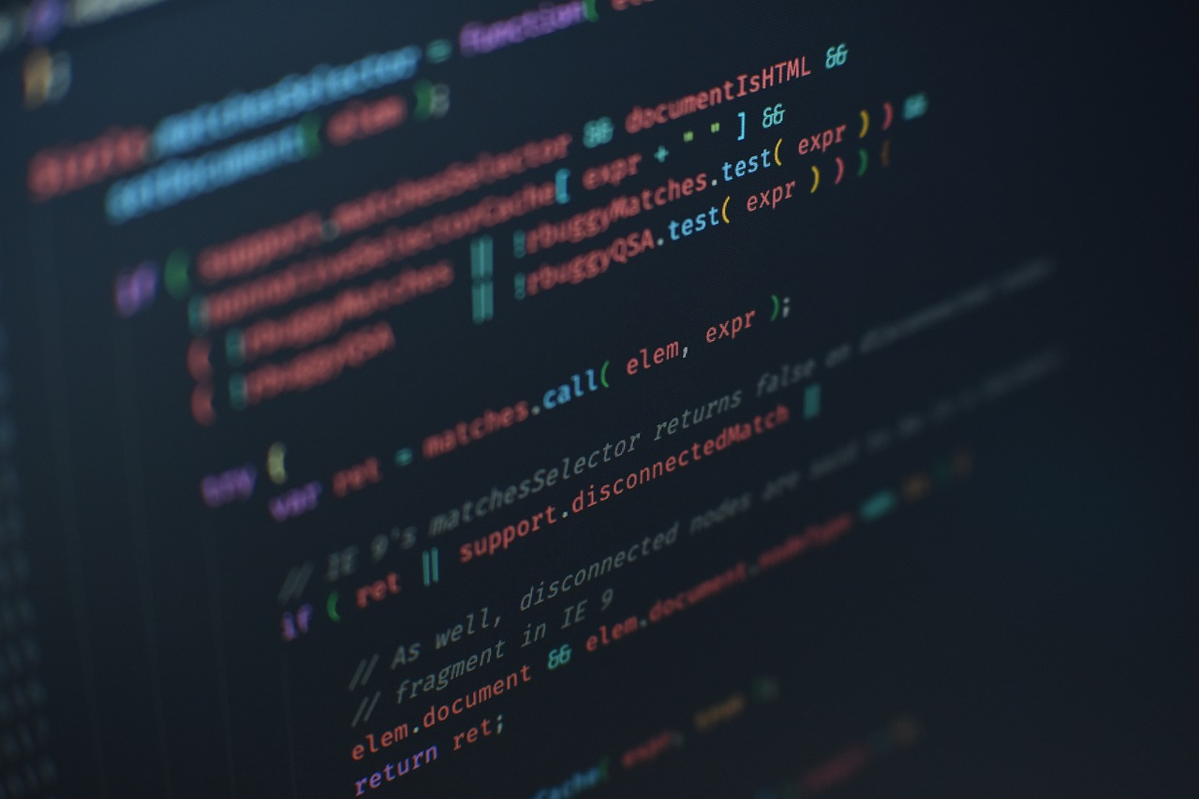


AI Labs
Intro to Git and GitHub
March 2025
© Management Solutions 2025. All rights reserved

Slide 2




01
Intro to Git and GitHub
02
The Git Workflow
03
Commonly Used Commands
04
Using GitHub
05
Integration with VS Code

Slide 3

01
Introduction to Git and GitHub
A Widely Used Tool For Version Control
Git is an open source, versioning control tool that we’ll use to facilitate collaborative work on our Proof of Concepts. GitHub is a company that builds tools that leverage Git.
GIT
GitHub
Git was created in 2005 with the intention of being a fast, free, and easy to use version control system often used for collaborative projects.
At the surface, it allows multiple developers to work on the same project, without the risk of impacting each others workflow.
Users have the ability to create their own versions or Branches of source code, that they can then alter without impacting the original script
When changes are ready to be added to the source code they can be Pushed to the central repository
GitHub is a cloud service that makes Git easier to use by hosting centralized Repositories that can be used to host source code and track changes.
GitHub also provides additional version control features such as authentication controls and a web-based interface to monitor projects.
While most Git Commands are executed through the command line, GitHubs web interface allows those less experience with the command line to navigate and review updates to the source code, as well as version histories.

Slide 4
02
The Git WorkFlow
Branching and version control
Generally, the Git workflow involves creating an agreed upon “Main Branch” of code along with a development branch that’s used for testing, and any number of feature branches that are used to create potential new additions.
The Main Branch
The main branch is generally a mainstay in the Git workflow and will usually contain the official code releases, or for our purposes, the official model pipeline including data preprocessing, model training, and testing. Ideally changes will not be made directly to the main branch until tested and agreed upon code from the development branch is reviewed. When new code is ready to be added to the main branch from the development branch, the two branches will be merged, incorporating the desired changes.
The Development Branch
The development branch can be used as a testing environment that mirrors the main branch. Newly created features can be moved into the development branch to test how they impact the stability of the main code before being pushed to the main branch. For our purposes, we could use this branch to test new steps in the development or inference pipelines.
Please Note:
This structure is just an example of how branching can be used in a collaborative structure. In reality there are a number of possibilities for branching and merging new versions of code as the team builds out their vision for the final product.
Feature Branches
With the main branch to hold stable code and the development branch for testing, any number of branches can be created to develop new ideas to add to the main branch. These ideas can be created on feature branches that are pushed to the development branch to ensure they don’t break anything and carried over to the main branch once finalized.

Slide 5
02
The Git WorkFlow
Working locally on a shared repository
While the “True” version of project code will be held on GitHub, it is possible to work on this code via your local machine by linking to the GitHub repository and pulling copies of the source code.
Central Repository
A central repository is created in GitHub that will act as the Source, or primary version of our project code.
Pull Request
When a developer wants to make changes or add to the source code, they will execute a Pull request to save a copy of the source code to their local machine.
Push Request
When the changes are complete and ready to be finalized, the developer can then Push these changes back to the central repository.
Code Development
The developer can then make changes and run tests without altering the original, shared source code.

Slide 6
02
The Git WorkFlow
Initializing, Staging, and Committing New Code
When pushing and pulling code from a central repository, you need to go through a series of steps to connect to the repository (initialize), pull the necessary files for your work (clone/pull) and identify the files you plan to update and push.
Step 1: Initialize your project using Git
In order to use Git to track project versions you first need to initialize the folder/project you want to track changes for. This can be a folder located on your computer, or you can connect remotely to an online repository.
Step 2: Add the files you want to track
Once Git has been initialized, you can then call out the some or all of the files within your initialized folder that you want to track changes for.
Step 3: Commit new changes to the files
As you work, you can commit (or save) the updated versions of your file along with a note about what changes were made. All commits will be saved to a log and one can access prior versions of tracked files using the commit IDs.
Step 4: Push changes to remote repository
When ready, you can push your commits (both current version and history) to the shared repository by pushing to whichever branch you’re working on.

Slide 7
03
Commonly Used Git Commands
Using the command line to execute actions using Git
Git commands can be executed via the command line and are used execute tasks within the Git workflow such as creating branches, pushing and pulling code, and connecting with a GitHub repository.
Command | Description
git init | Initialize an existing directory as a Git Repository
git add [file name] | Add files to the staging area (note which files you want to track changes for)
git commit –m “[message]” | Save the current status of your staged files as a commit
git log | Show the commit history for the currently active branch
git branch [branch-name] | Create a new branch at the current commit
git remote add origin [url] | Connect to an existing repository from the specified URL
git clone [url] | Retrieve an existing repository from the specified URL
git merge [branch] | Merge a specific branch’s history into the current one
git push origin [branch] | Push local commits to a specified branch in the remote repository
git pull | Fetch and merge any commits from the remote version of the branch you’re working on
git checkout [branch] | Switch to another branch
git fetch origin | Fetch all branches from the connected remote repository

Slide 8
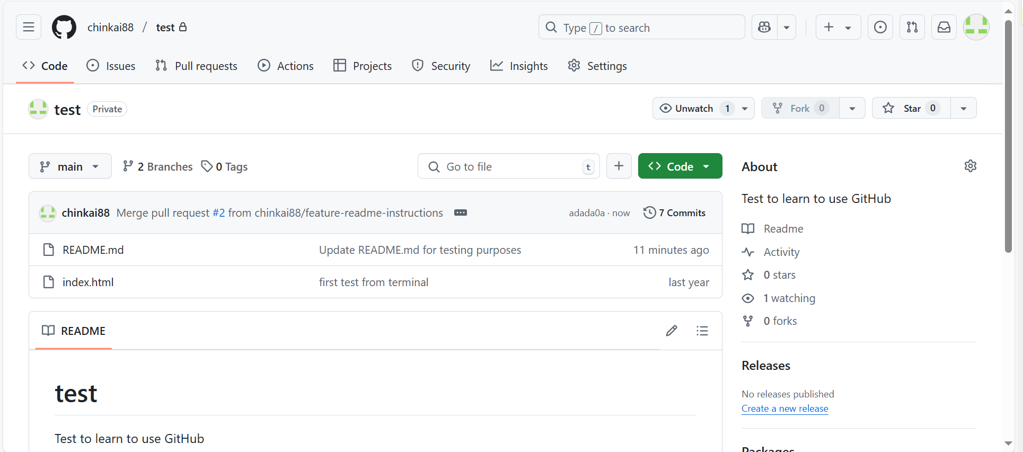
04
Using GitHub
GitHub’s interface
GitHub’s UI can be used to view and perform actions such as merges, pull requests, and even directly editing files within the repository.
Username
Current Repository
Branches in the project
Options to download repository as well as URL to connect remotely
Current Branch
Files in repository
View and access history of commits for the selected branch
Options to view and edit selected files

Slide 9
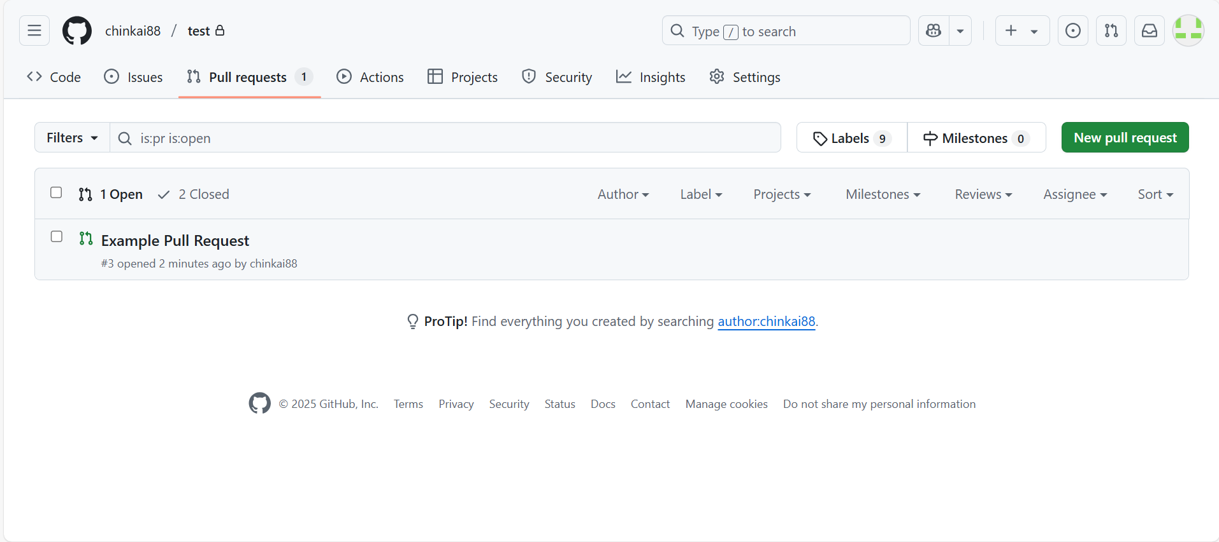
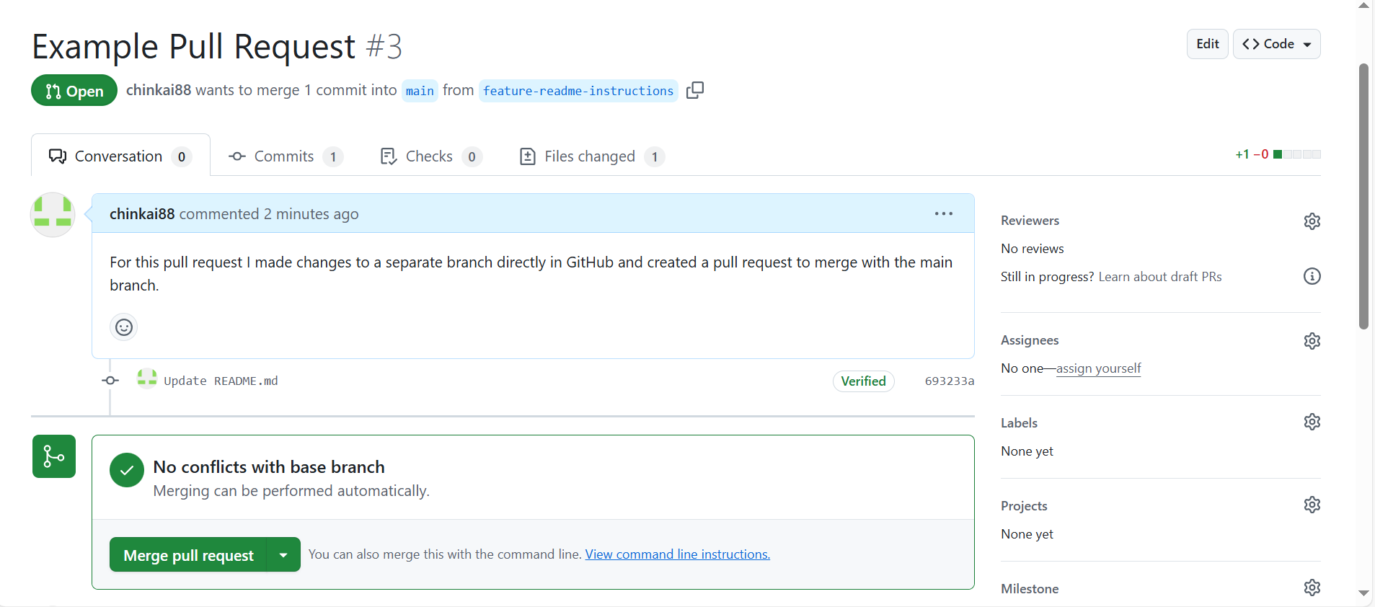
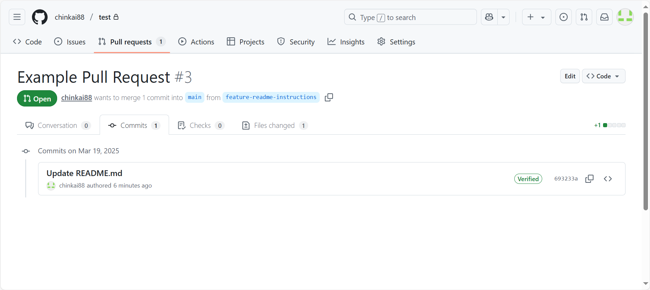
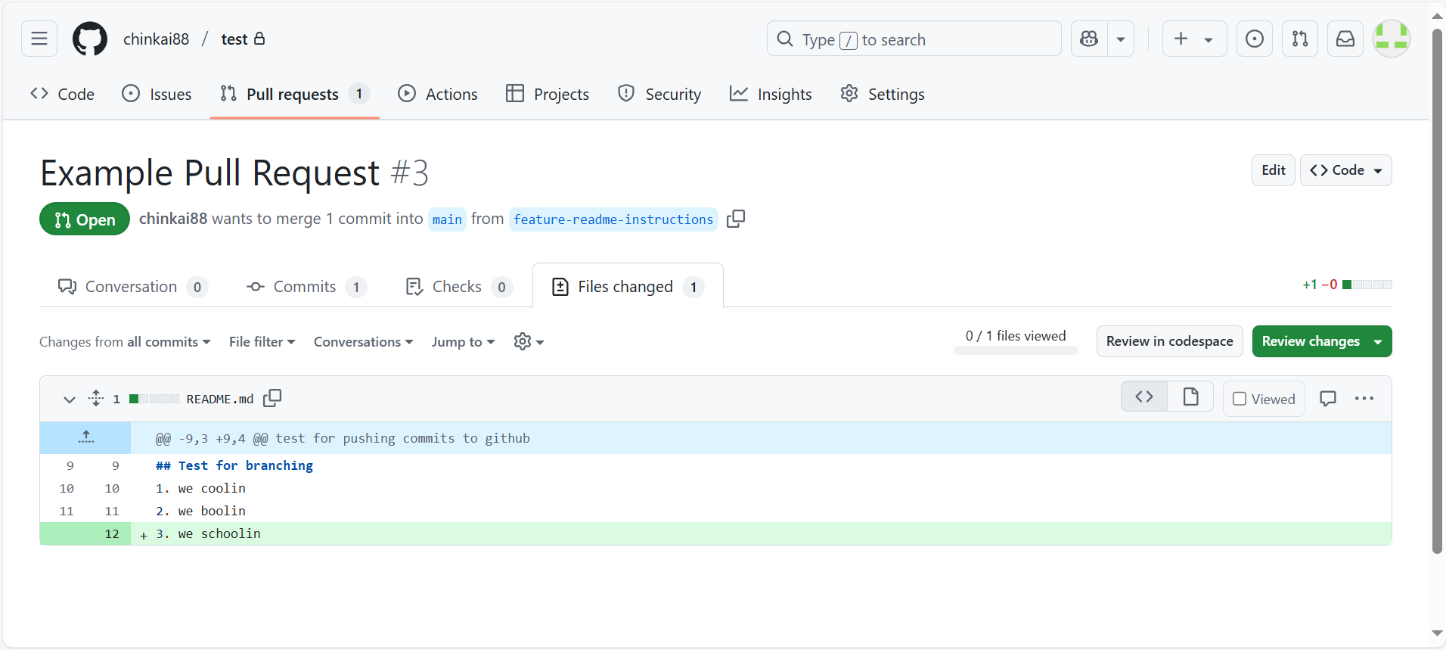
04
Using GitHub
Pull Requests
The Pull requests tab in particular is useful for monitoring when someone wants to merge changes, made either remotely or directly on GitHub, with an existing branch.
Outstanding requests to updated branches
User-created description of the updates and option to accept or deny
History of commits made to the updated branch to be merged
Changes made to file(s) in repository

Slide 10
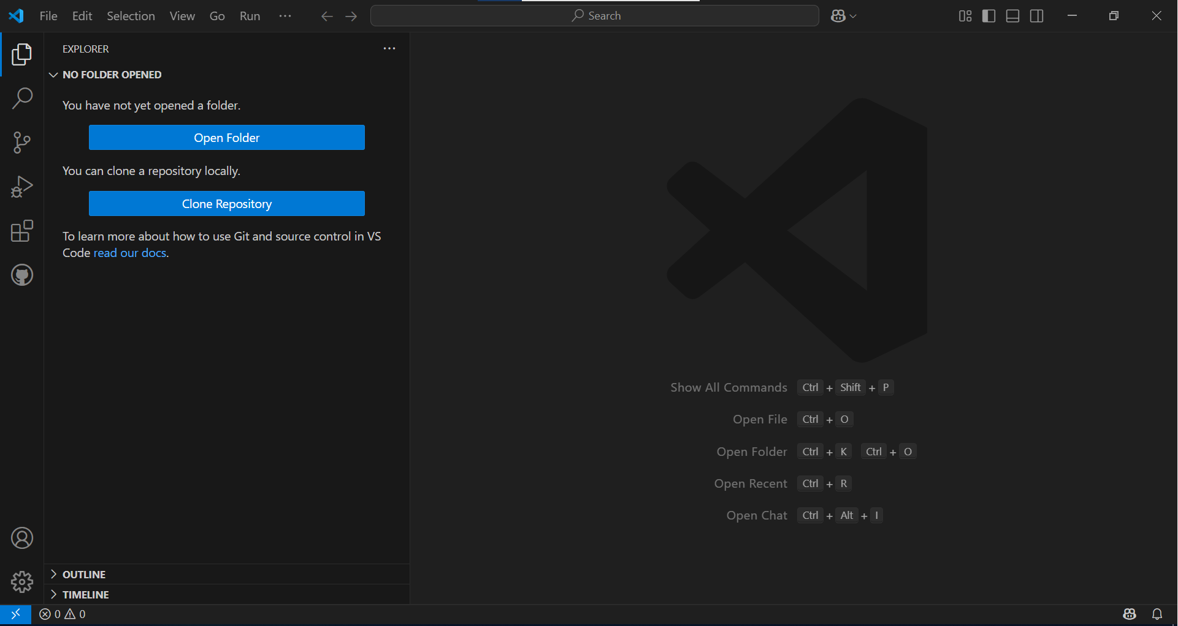
05
Integration with VS Code
Initializing or connecting to repositories
The GitHub Pull Requests Extension for VS code allows for integration between the tools including UI options for cloning repositories, monitoring user created issues, and viewing and creating pull requests.
Create or open folder from local system
Open and clone a folder from a GitHub repository

Slide 11
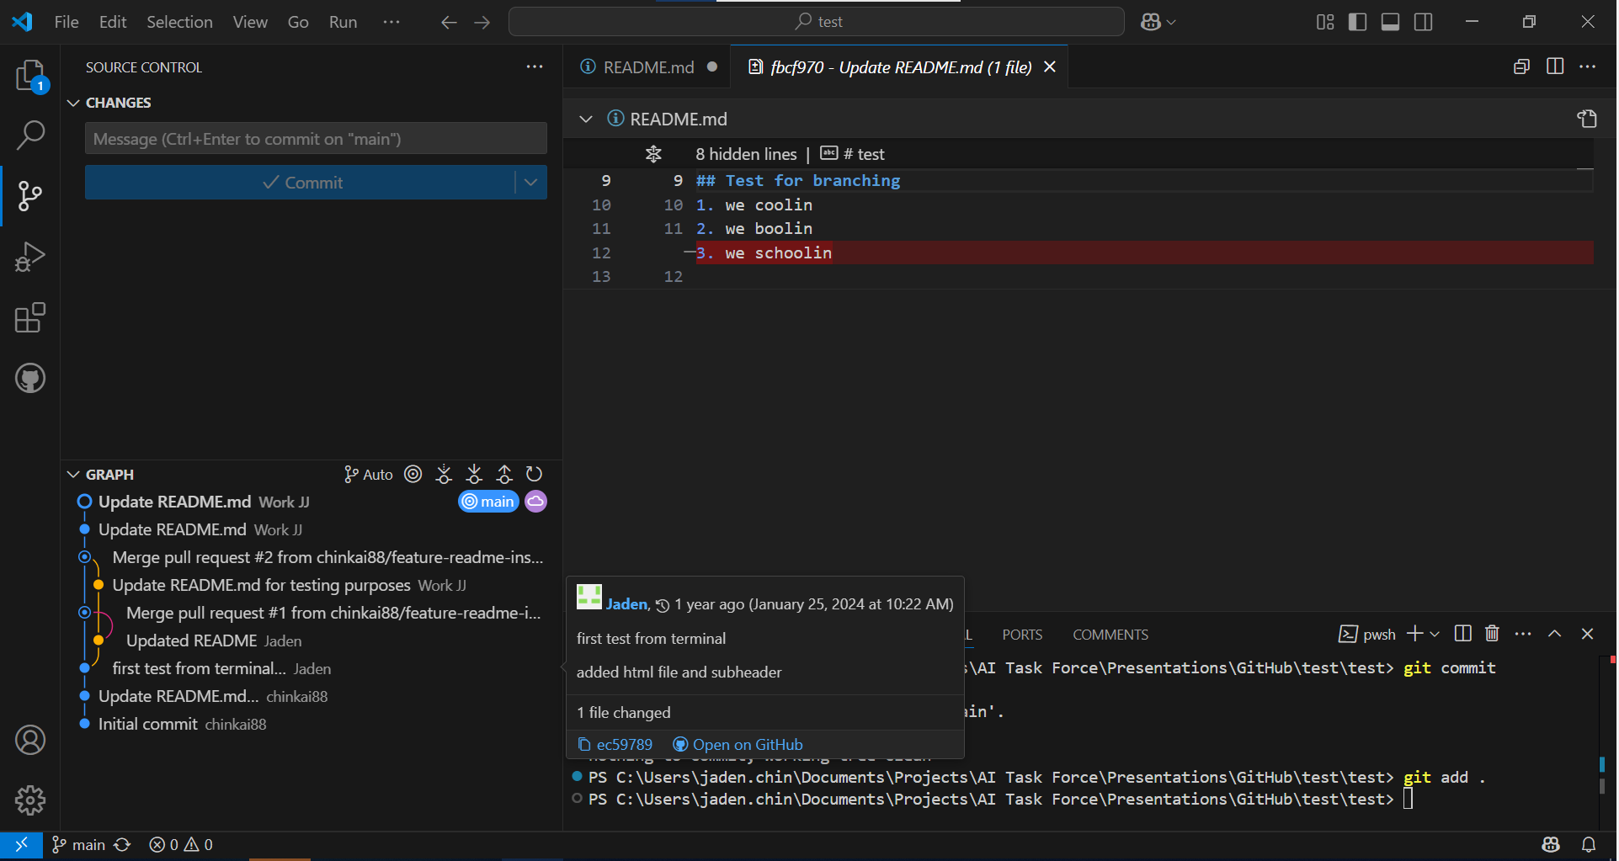
05
Integration with VS Code
Source Control
The source control tab allows the user to execute git commands such as creating branches, committing new changes, and accessing old commits without using the command line.
Create commits
View project history and execute push, pull, and merge commands
View past commits

Slide 12
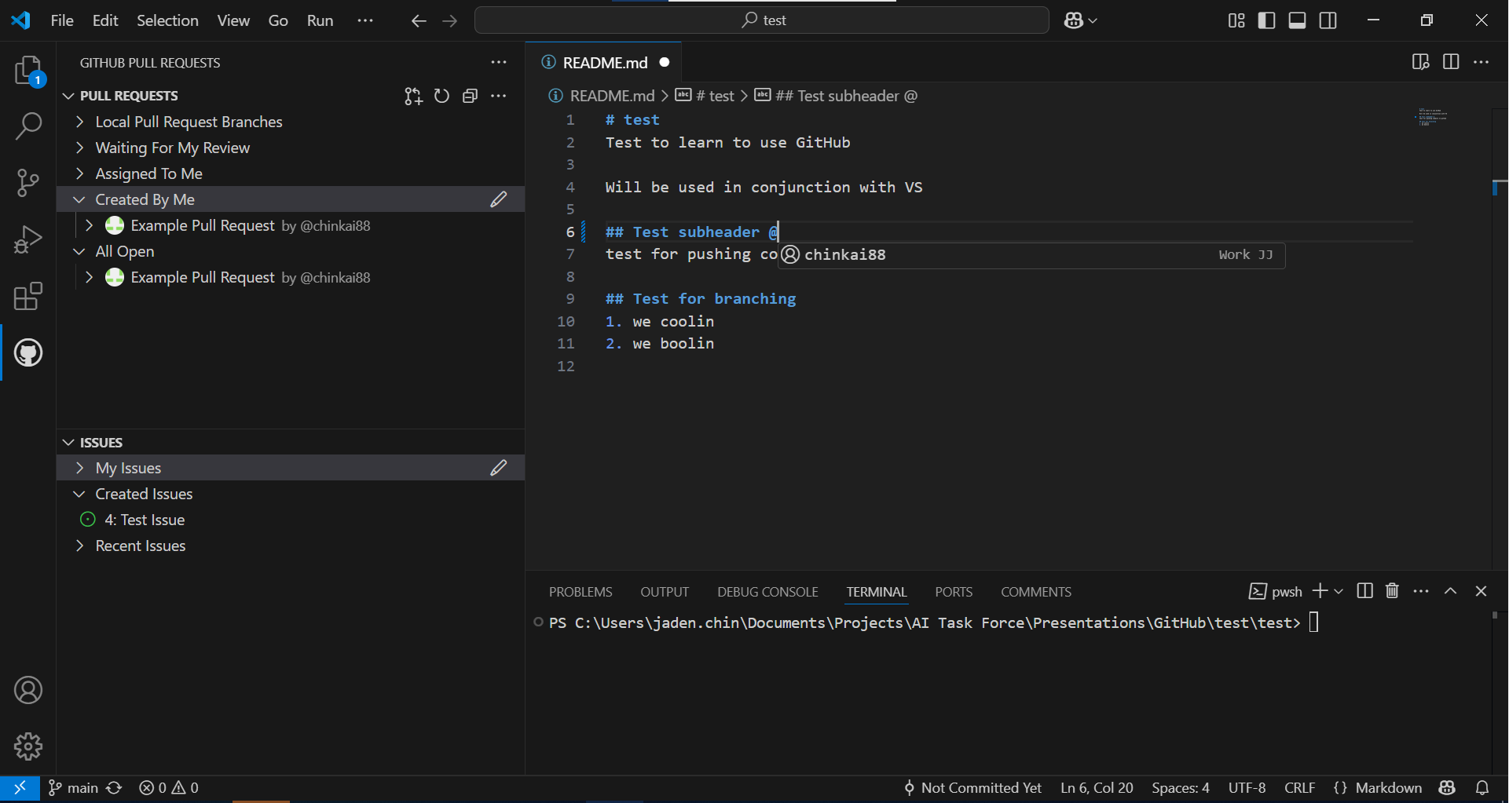
05
Integration with VS Code
GitHub Pull Requests
The pull requests tab can be used to view and generate pull requests, create and monitor issues, and directly open existing pull requests on GitHub.
View current pull requests and create new ones
Users who have access to the repository can be mentioned with inline comments
View issues created in the repository
Changes to tracked file are highlighted in blue in the “gutter” on the side of the screen
Current Branch

Slide 13






International
One Firm
Multiscope
Team
Best practice
know-how
Proven
Experience
Maximum
Commitment
CONTACTS
Patricia Pajuelo Gaviro
Partner – US Services
patricia.pajuelo@msnorthamerica.com

